Slide 1
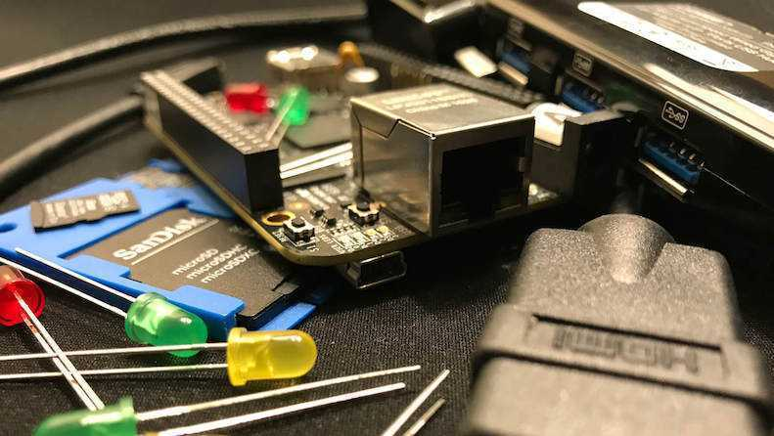


PocketBeagle TechLab Workshop

Slide 2

PocketBeagle walk-through
Friendly to novices and experts alike, the Beagle experience tracks mainline u-boot, Linux and Debian development, while augmenting it to enable development to start as quickly as possible. Attendees will get started interacting with the hardware via the command-line, shell scripts, Python and JavaScript. Attendees will be walked through the configuration details for the boot configuration, pin multiplexing, USB networking and other helper scripts they should get to know. Support and development processes within the BeagleBoard.org community will be covered. Exercises will pave the way for the other workshops to dive into their topic without needing to backtrack excessively on PocketBeagle-specific details.

Slide 3
Author and license
Author
Jason Kridner Co-founder BeagleBoard.org, Texas Instruments Sitara apps https://beagleboard.org/about
License
Creative Commons Attribution – Share Alike 4.0 https://creativecommons.org/licenses/by-sa/4.0/

Slide 4
Outline
BeagleBoard.org, PocketBeagle and BaconBits
Developer experience
Command-line and shell script
JavaScript and Python
C/C++
C on PRUs
Project examples
Labs

Slide 5
BeagleBoard.org’s objectives
Education
Design and use of open source SW/HW
Embedded computing
Collaboration
Physical computing
Robotics
Industrial/machine controls

Slide 6
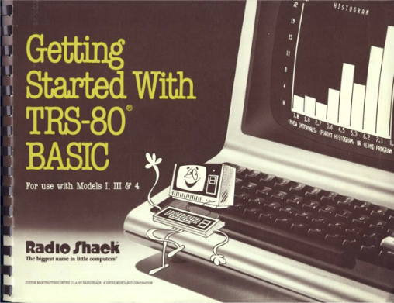
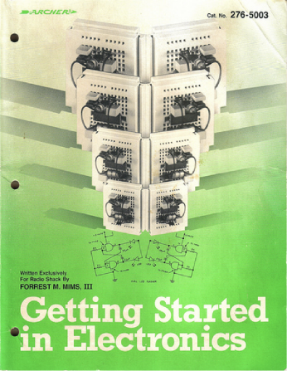
Inspiration from early PCs
http://newcome.wordpress.com/2009/12/15/make-electronics-the-new-engineers-notebook/
http://www.sandywalsh.com/2012_07_01_archive.html

Slide 7
Inspiration from early PCs
How do people learn about embedded computers with so much ground to cover?
http://newcome.wordpress.com/2009/12/15/make-electronics-the-new-engineers-notebook/
http://www.sandywalsh.com/2012_07_01_archive.html

Slide 8
Inspiration from early PCs
How do people learn about embedded computers with so much ground to cover?
Linux keeps history
Affordable -> hackable
Open from boot
High-level languages
Motivate with hardware
http://newcome.wordpress.com/2009/12/15/make-electronics-the-new-engineers-notebook/
http://www.sandywalsh.com/2012_07_01_archive.html

Slide 9
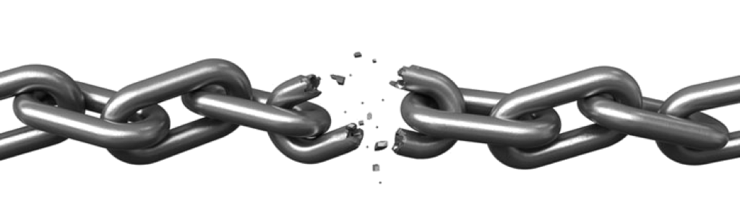


Vision
Creating with electronics should be as easy as creating a web page

Slide 10
Vision
Creating with electronics should be as easy as creating a web page
Appliances are better than applications

Slide 11
Vision
Creating with electronics should be as easy as creating a web page
Appliances are better than applications
Open source software and hardware enable
Collaboration on the problem
Ability to understand and improve the fundamentals

Slide 12
Reality
Boot-to-browser feels too limiting → booting to Debian distro
Collaborative programming still complex → collaborate at the kernel
Many possible development environments
command-line/ssh, Cloud9 IDE, node-red, pureData, SuperCollider, LabView, Matlab, Eclipse, Visual Studio, Scratch, Blockly
Domain specific approaches
Machinekit/LinuxCNC, PLC, many IoT toolkits
Many rapid sensor approaches: capes, mikroBus, Grove/Grove Zero, PMOD
Many rapid build approaches: LEGO, printing/milling, Makeblock, Vex, various other aluminum kits

Slide 13
Approach
Don’t try to boil the ocean
We seek to engage the open source community
Help where we can
Blue supports Grove cables
PocketBeagle supports mikroBus click pinout
Many “BeagleBoard Compatible” devices targeting specific application areas

Slide 14

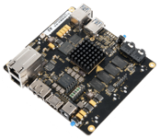
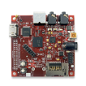
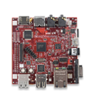
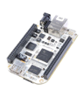
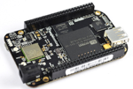
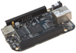
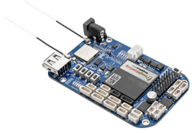
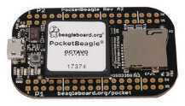
Board history
Fanless open computer (BeagleBoard)
$249
Mint tin sized with industrial peripherals (BeagleBone)
$69
Application focused BeagleBones
$79
Smalls mint tin sized with super-flexible design - PocketBeagle
$25

Slide 15
PocketBeagle objectives
Get simple
4-layer PCB done in both Kicad and EAGLE
Every expansion header pin has a useful predefined mode
Get flexible
USB to holes, no on-board pin consumption, no header soldered
Support for 2 mikroBus Click boards (over 300 already exist)
Get small
Stick with mint-tin survival-kit theme, but go to “smalls” (35mm x 55mm)
Get low cost
System-in-package approach has can lower build costs
Launched/sustainable at $25

Slide 16
PocketBeagle key features
Processing
1-GHz ARM Cortex-A8 processor
2x200-MHz programmable real-time units (PRUs)
ARM Cortex-M3 microcontroller for power and security
SGX530 graphics processor (OpenGLES)
Memory
512-MB DDR3
4-KB I2C EEPROM
Interfaces
USB 2.0 OTG
microSD
72 expansion header pins
8 analog inputs (6@1.8V, 2@3.3V)
44 digital I/Os (18 enabled)
3 UARTs (2 enabled)
2 I2C ports
2 SPI ports
2 quadrature encoders accessible
2 CAN bus controllers accessible
USB, power/reset buttons, battery/DC

Slide 17
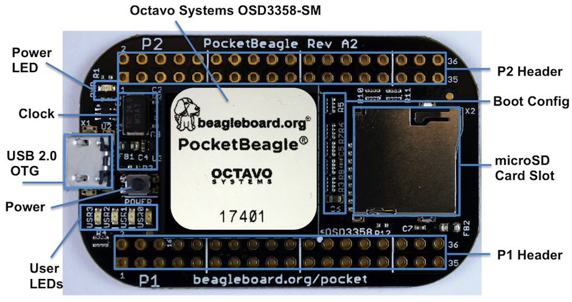
PocketBeagle top

Slide 18
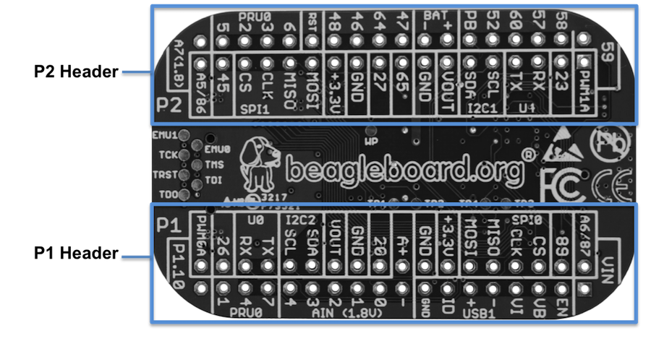
PocketBeagle bottom

Slide 19
PocketBeagle bottom
44

Slide 20
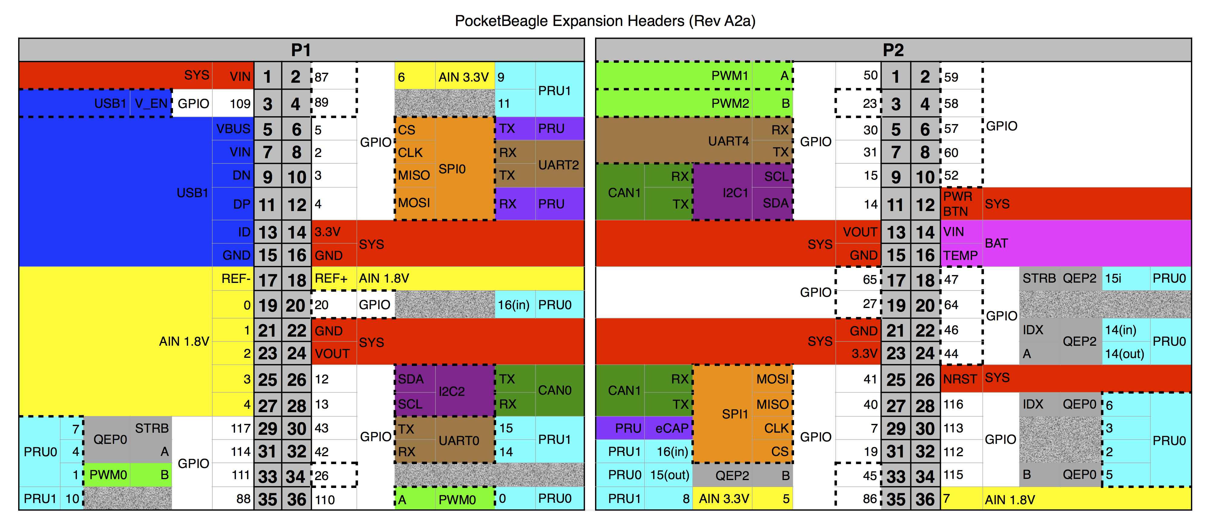
PocketBeagle expansion

Slide 21
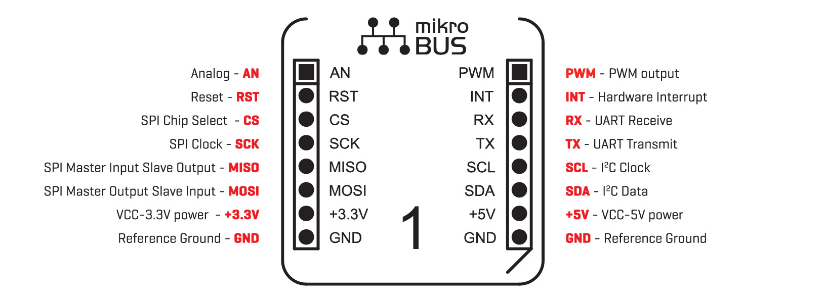
mikroBus Click

Slide 22
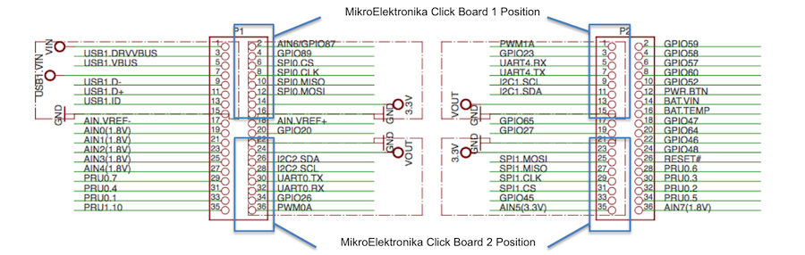
Connecting mikroBus Clicks

Slide 23
TechLab objectives
Designed specifically for e-ale training
Inspired by “Bacon Cape” by Dave Anders
Designed for similar purpose on BeagleBone
Migrated to PocketBeagle as “BaconBits” by Michael Welling
Updated to have mikroBus header and made “pretty”
Extra button (with PRU option), light sensor rather than potentiometer
Provides target for common embedded interfaces
SPI, I2C, GPIO, PWM, ADC, USB, serial
Avoid users needing to buy several modules

Slide 24
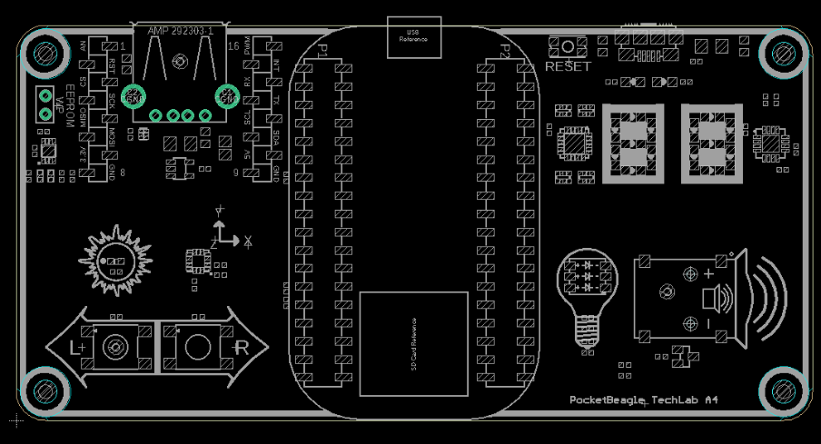
TechLab features
USB-to-Serial micro B
USB Host A with power
Reset button
2 GPIO push buttons (L and R)
ADC light sensor
PWM tri-color LED
SPI 2-digit 7-segment display
I2C accelerometer
mikroBus header

Slide 25
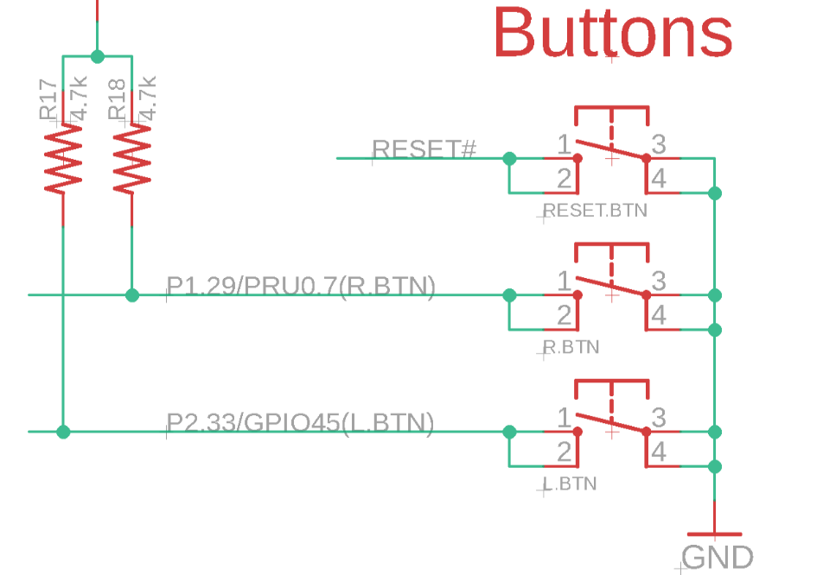
TechLab GPIO inputs

Slide 26
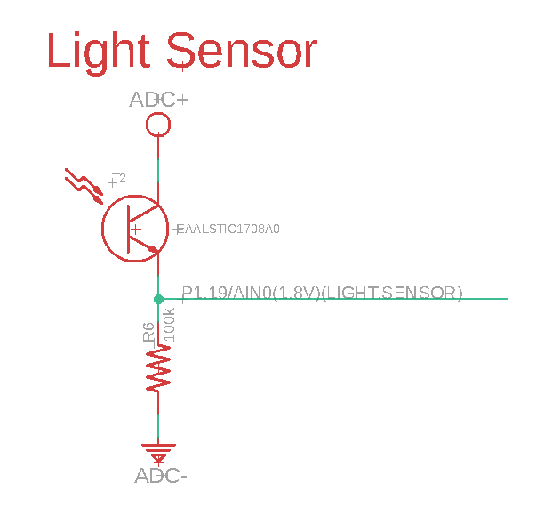
TechLab ADC input

Slide 27
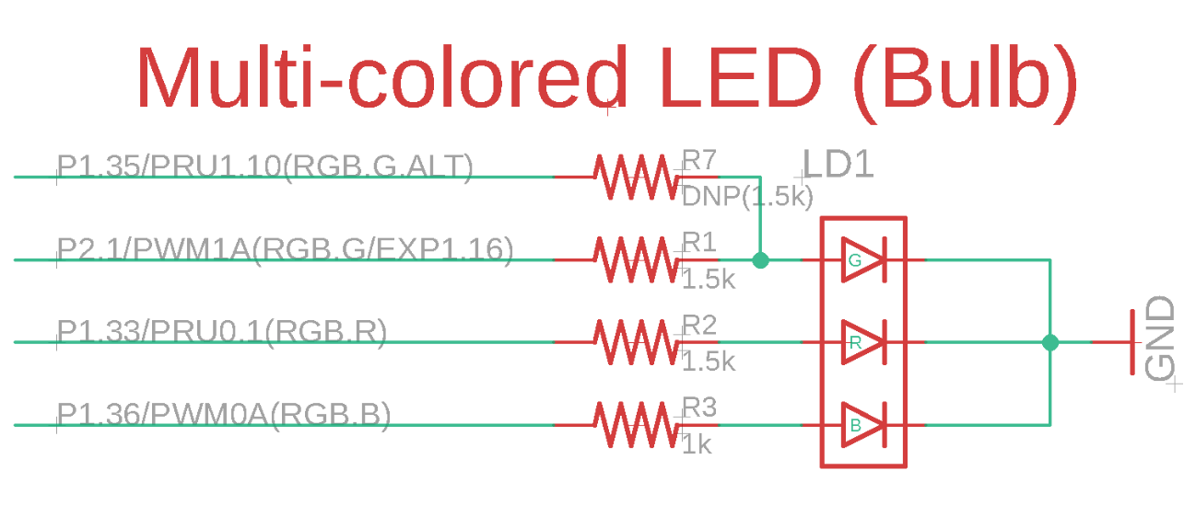
TechLab PWM output

Slide 28
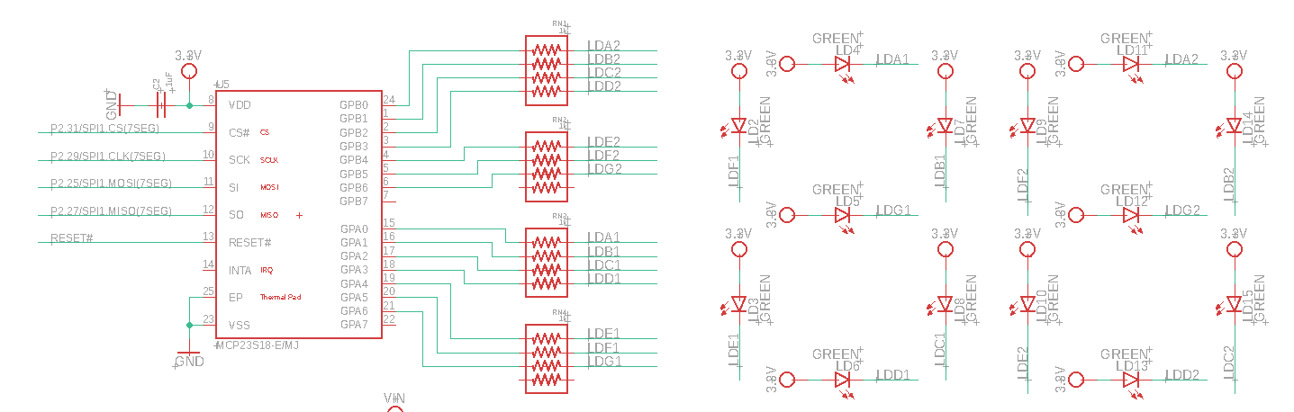
TechLab SPI 7-segment display

Slide 29
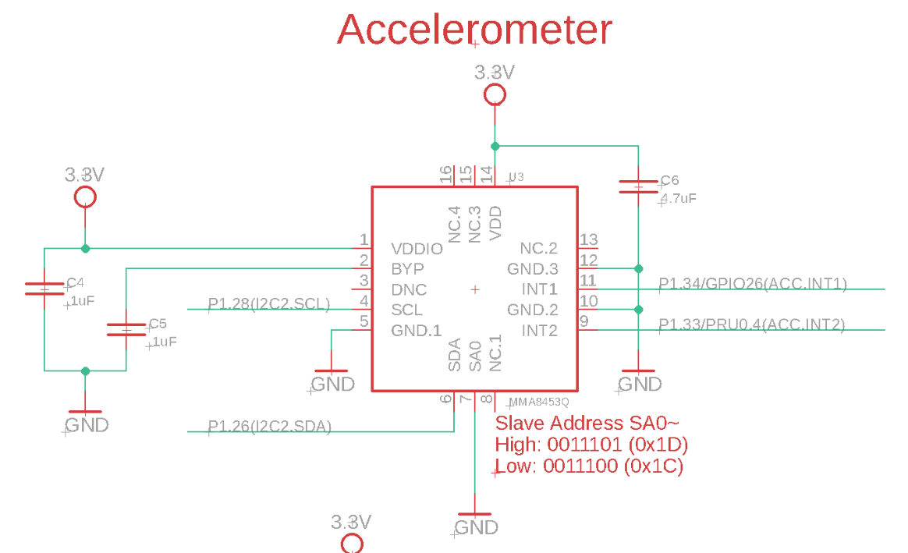
TechLab I2C sensor

Slide 30
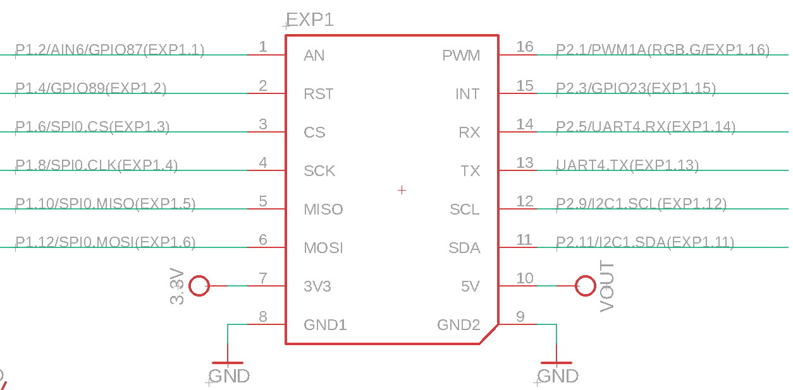
TechLab mikroBus header

Slide 31
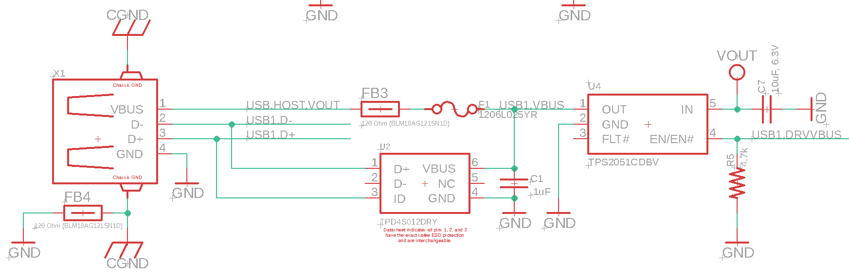
TechLab USB host

Slide 32
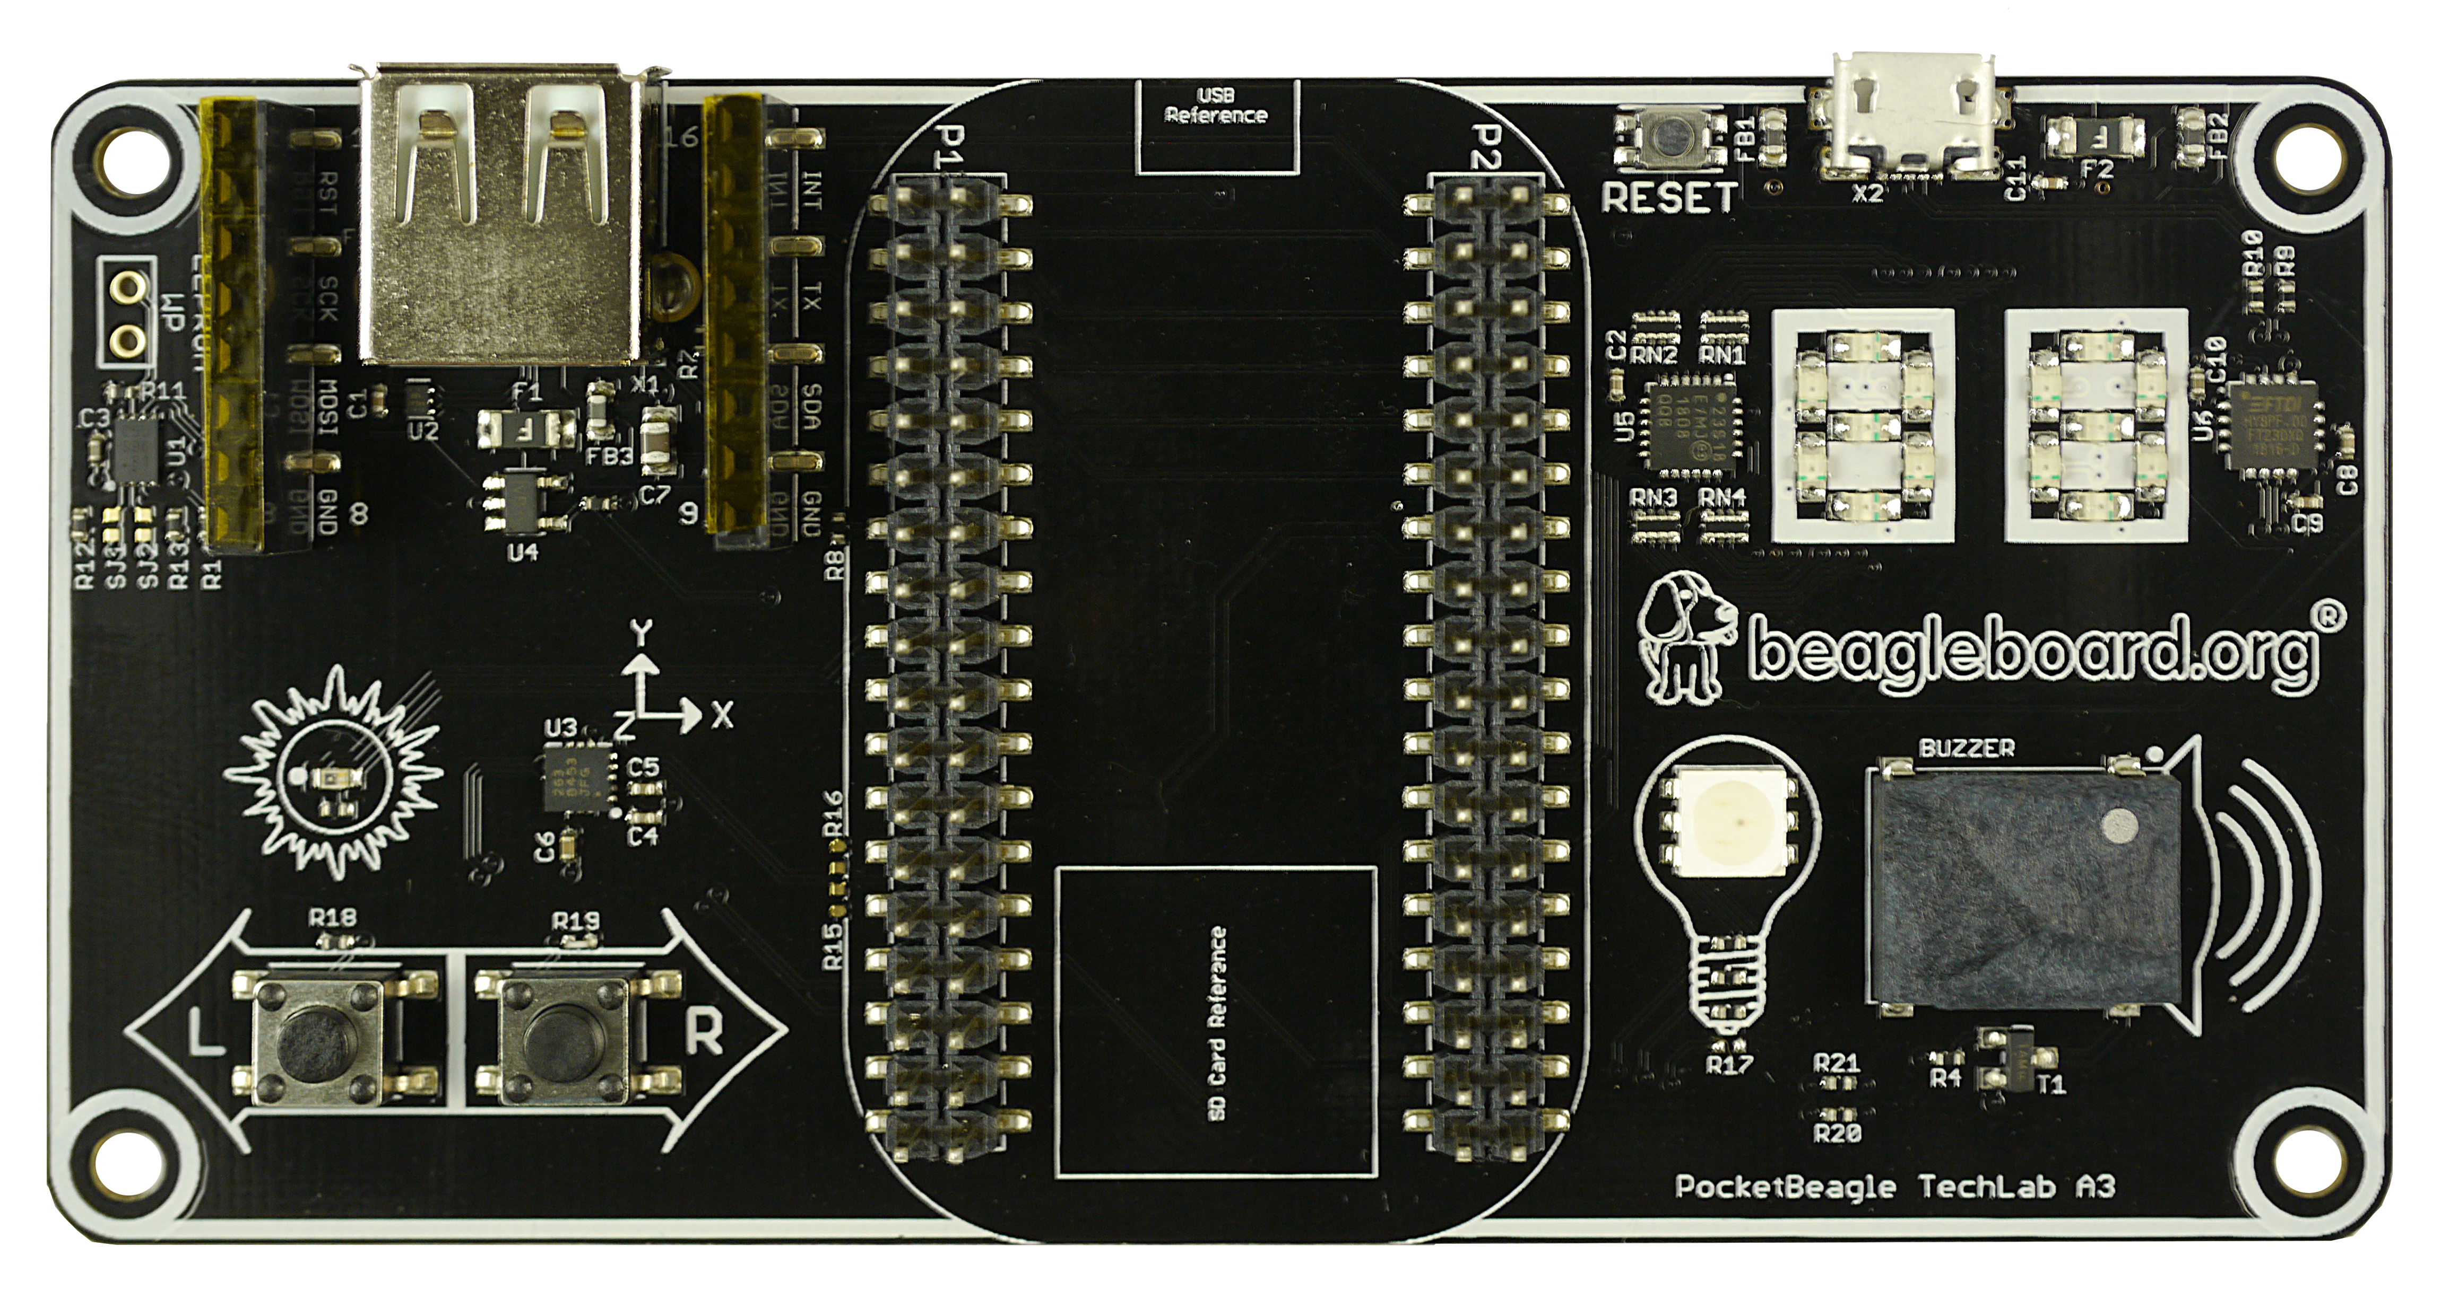
TechLab board image

Slide 33
Developer experience
Customized Debian images – bbb.io/latest
Self-hosted tools for ARMs and PRU
Libraries for various high-level languages
Scripts for common tasks
Sources for bootloader, device tree, etc.
Servers for network-based development

Slide 34
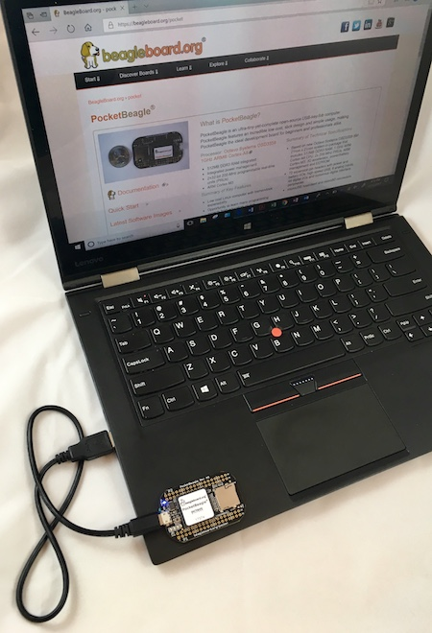
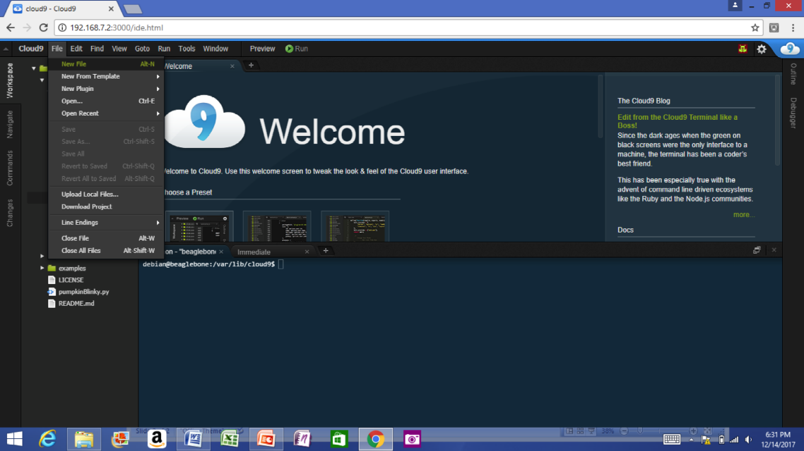
Single cable development
Power, network, develop
You can add a network and power many other ways

Slide 35
Some work in progress
Add proxy for various services (in Buster IoT images today)
Integrate common web-based WiFi provisioning
SeeedStudio BealgeBone Green Wireless ships with ‘wifidog’ → we will unify approach
Cross-platform distro installer app
See USB NETCONSOLE presentation
Support for Grove modules and mikroBus clicks
Focus on device-tree overlays and kernel patches
Integration alignment with complete domain solutions
Intelligent Agent Replicape/Revolve, Bela Mini, BeagleLogic, etc.
Improved and integrated PRU examples
Move to distro friendly approaches for customizations

Slide 36
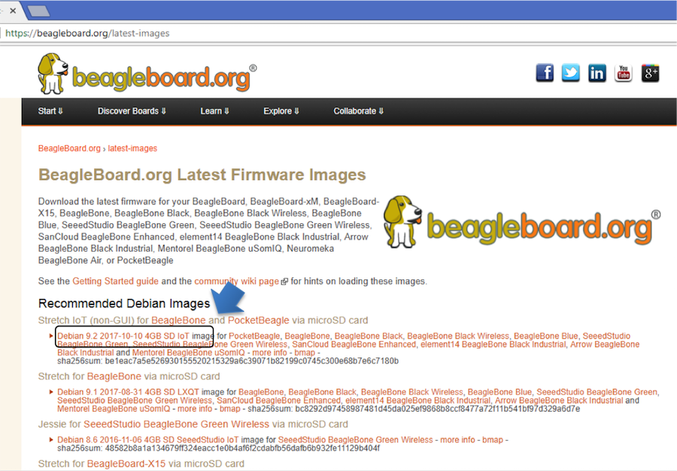
Download image

Slide 37
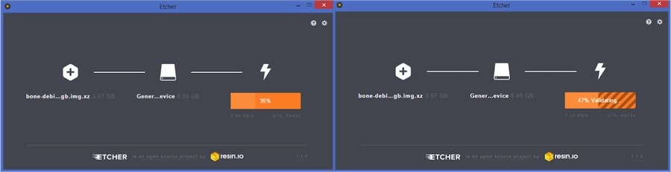
Write image to microSD with Etcher

Slide 38
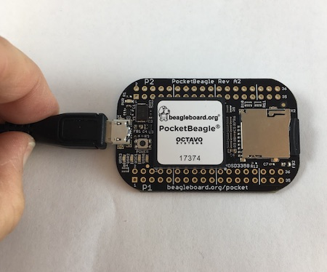
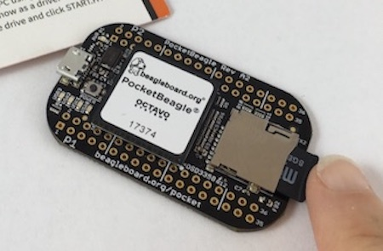
Insert microSD and boot

Slide 39
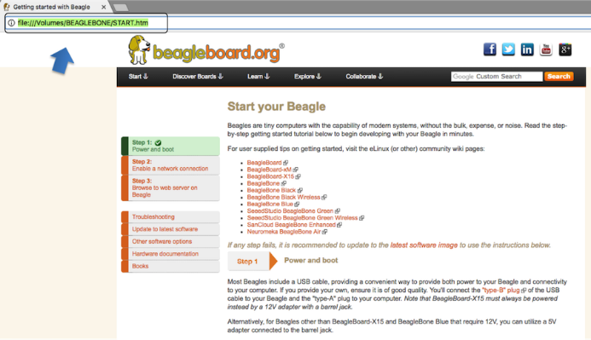
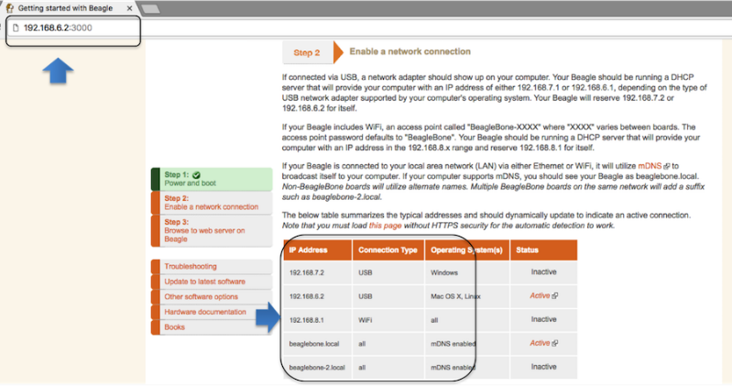
Connect to the USB network

Slide 40
Open the IDE

Slide 41
See labs in the Handouts
No need to program the microSD card
The link is for your reference. This is already done for you.
Do the first 4 labs
“Blink PocketBeagle on-board USRx LED”
“Read a button”
“Read an analog sensor”
“Fade an LED”
I will interrupt with hints and discussion at intervals

Slide 42
USB gadgets
Linux name for device/slave drivers
ie., when not host
USB devices have “classes”
Mass storage
Camera
Audio
Printer
“HID” or human-interface device like mouse and keyboard
Communications

Slide 43
USB gadgets
Default image USB gadgets
Virtual mass storage
Serves you up README.htm
Virtual serial
Provides access to console after kernel boot
Virtual network
Enables access to ssh and web servers

Slide 44
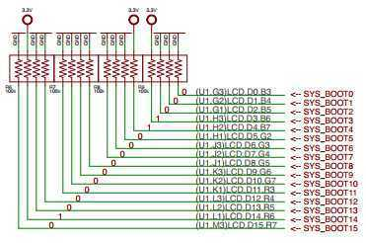
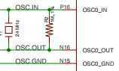
TI AM335x: bootrom
From: (AM335x and AMIC110 Sitara™ Processors Technical Reference Manual (Rev. P))
http://www.ti.com/lit/ug/spruh73p/spruh73p.pdf (page 5032)
SYSBOOT[15:14] = 01 = 24Mhz
SYSBOOT[4:0] = 11000
SPI0
MMC0 - going to use today
USB0 - (node-beagle-boot)
UART0

Slide 45
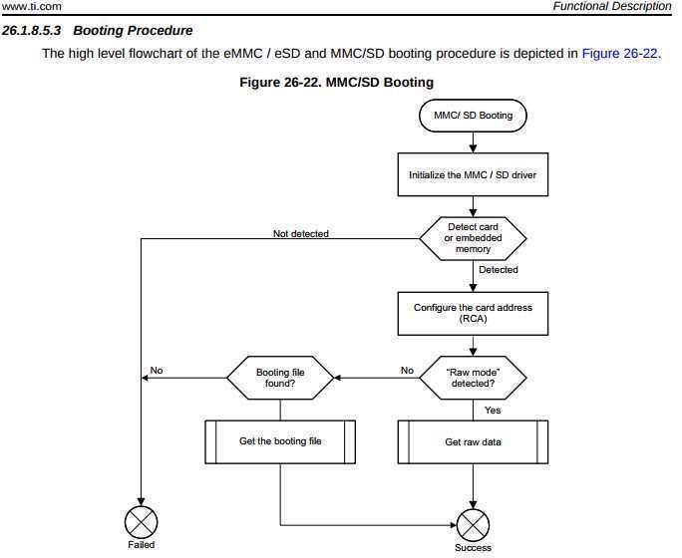
TI AM335x: bootrom
http://www.ti.com/lit/ug/spruh73p/spruh73p.pdf
Page: 5053
MLO

Slide 46
TI AM335x: bootrom: raw mode:
http://www.ti.com/lit/ug/spruh73p/spruh73p.pdf (Page: 5054)
0x0 <- (FAT Boot Sector, let's leave it blank...)
0x20000 (128KB) <- We are going to use this location
0x40000 (256KB) <- (2nd “backup” location)
0x60000 (384KB) <- (3rd “backup” location)
Only 128KB in size… (hint, only 128KB of SRAM)

Slide 47
Das U-Boot (the Universal Boot Loader) U-Boot
Original Author: Wolfgang Denk, now maintained by Tom Rini
https://www.denx.de/wiki/U-Boot
http://git.denx.de/?p=u-boot.git;a=summary
https://en.wikipedia.org/wiki/Das_U-Boot

Slide 48
U-Boot: AM335x
Outputs two files for TI am335x targets:
MLO = SPL (or Secondary Program Loader)
u-boot.img (or u-boot-dtb.img) (U-Boot)
ROM
SPL
UBoot

Slide 49
U-Boot: SPL
Initializes main memory (DDRx for am335x)
Loads full (U-Boot) into DDR memory
Or:
Initializes main memory (DDRx for am335x)
Loads Linux Kernel into DDR memory (aka: Falcon mode, faster boot mode/etc)

Slide 50
U-Boot:
Network
USB
MMC
File System (fat/extX)
Shell
Sometimes you don’t need a full OS, have U-Boot init and then have U-Boot load/run your application.

Slide 51
U-Boot:
CPU : AM335X-GP rev 2.1 I2C: ready DRAM: 512 MiB Some drivers were not found Reset Source: Power-on reset has occurred. MMC: OMAP SD/MMC: 0, OMAP SD/MMC: 1 Using default environment Board: BeagleBone Black <ethaddr> not set. Validating first E-fuse MAC BeagleBone Black: Model: SeeedStudio BeagleBone Green:

Slide 52
U-Boot: microSD
Insert USB-microSD adapter, and type “lsblk”
voodoo@hestia:~/Supercon-2017-PocketBeagle$ lsblk NAME MAJ:MIN RM SIZE RO TYPE MOUNTPOINT sda 8:0 0 465.8G 0 disk └─sda1 8:1 0 465.8G 0 part / sde 8:64 1 7.4G 0 disk └─sde1 8:65 1 7.4G 0 part
Open: system.sh change: MMC=/dev/sde
That’s our 8GB USB Flash Drive

Slide 53
U-Boot: Format microSD
sudo dd if=/dev/zero of=${MMC} bs=1M count=10 sudo sfdisk ${MMC} <<-__EOF__ 4M,,L,* __EOF__ sudo mkfs.ext4 -L rootfs ${MMC}1
voodoo@hestia:~/Supercon-2017-PocketBeagle$ ./scripts/format_drive.sh

Slide 54
U-Boot: (refresh for your memory)
http://www.ti.com/lit/ug/spruh73p/spruh73p.pdf (Page: 5054)
0x0
0x20000 (128KB) <- We are going to use this location
0x40000 (256KB)
0x60000 (384KB)
sudo dd if=./deploy/MLO of=${MMC} count=1 seek=1 bs=128k
sudo dd if=./deploy/u-boot.img of=${MMC} count=2 seek=1 bs=384k

Slide 55
Base Rootfs: Debian 9.x (Stretch)
Maintainer: Robert Nelson (with lots of help from all the Debian Developers and 1000’s of other users)
https://elinux.org/Beagleboard:BeagleBoneBlack_Debian#2017-11-05_-_Debian_9_.28Stretch.29_-_Weekly
https://www.debian.org/
https://github.com/beagleboard/image-builder

Slide 56
Device Tree
See kernel documentation for bindings
devicetree/bindings/eeprom/eeprom.txt
Local copies enable you to extend on the fly
/opt/source/dtb-4.14-ti
/opt/source/bb.org-overlays
Overlays loaded in u-boot, but also possible via kernel configfs

Slide 57
config-pin
config-pin -i p1.36
config-pin -q p1.36
config-pin p1.36 pruout

Slide 58
show-pins.pl
perl /opt/scripts/device/bone/show-pins.pl -v

Slide 59
mikroBus Click usage
See bbb.io/pbmb
Supported with device-tree overlays loaded in u-boot

Slide 60
Enabling PRU
2 possible drivers: remoteproc or uio
Enabled via device tree at boot
Different systems might have different defaults

Slide 61
Some current projects
Bela Mini
PocketPilot

Slide 62
Contributions and issues
Cape/add-on support
https://github.com/beagleboard/bb.org-overlays
Image deltas
https://github.com/beagleboard/image-builder
In-system examples
https://github.com/beagleboard/bone101

Slide 63
Questions?

Slide 64

Thank you!

